Slide 1
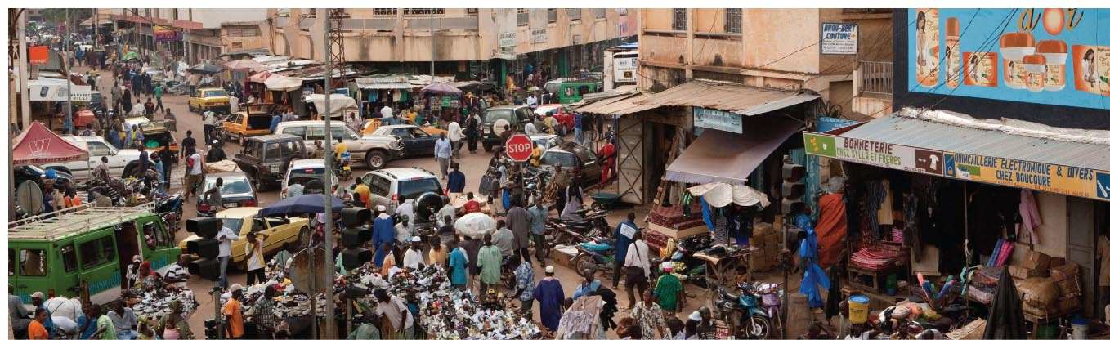
Key Concepts:
Urbanization
Urban expansion
Gateway & shock cities
Central place theory
Over-urbanization
Deindustrialization
Redlining
Segregation / Congregation

Slide 2
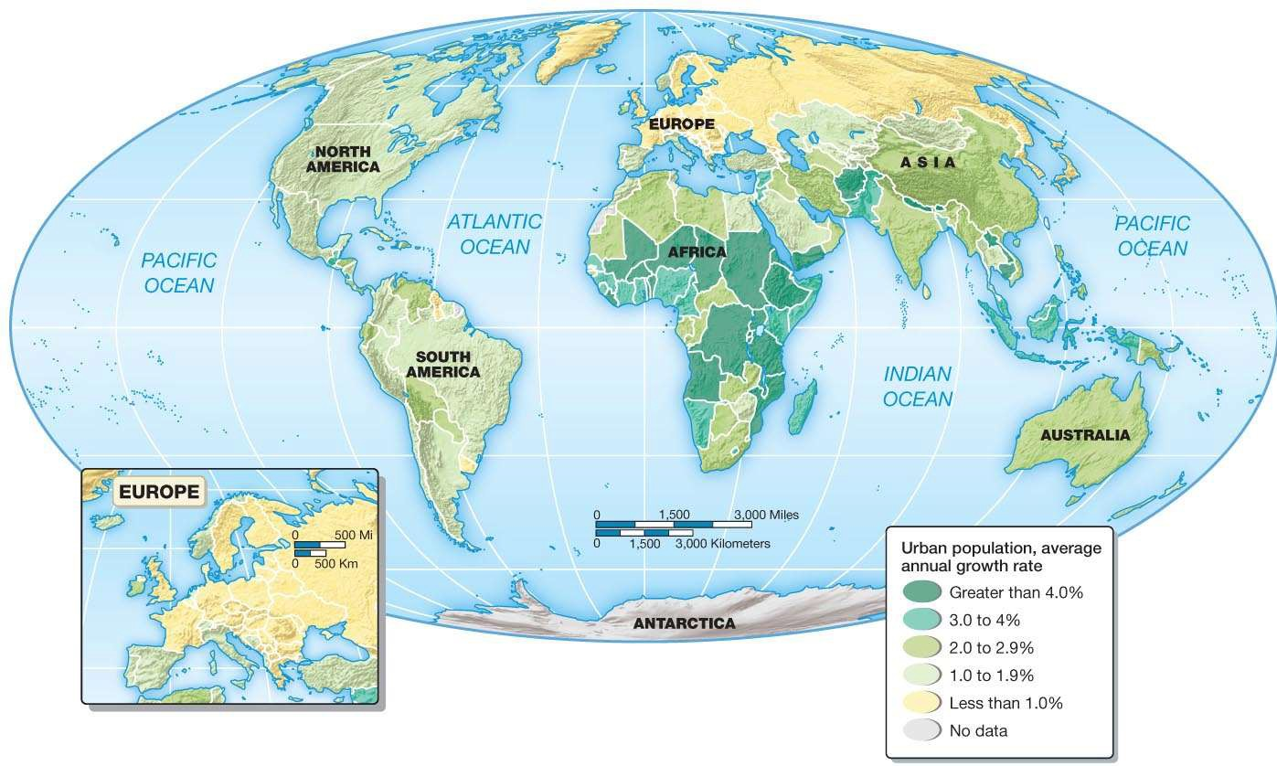
AFRICAN continent with highest rate of urban population growth globally
Figure 10.2 Rates of growth in urbanization, 2000–2010
© 2013 Pearson Education, Inc.

Slide 3
Global trend towards Urbanization
Populations concentrating in cities is one of the most important global geographic phenomena today.
50% of the World’s Population lives in Cities
United Nations Center for Human Settlements notes that the growth of cities & urbanization of rural areas are now irreversible due to global shift to technological, industrial, & service-based economies.
North America has highest concentration of people living in cities, >50%
African continent is largest urbanizing world region.

Slide 4
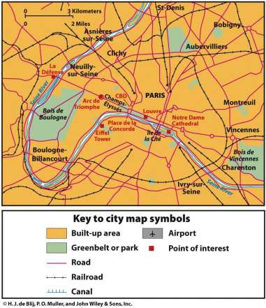
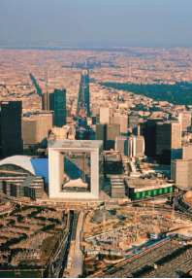
Urban History & Form
Urbanization
Related concepts:
  Primate city
  Metropolis
  CBD-
  Central Business Districts contain:
  Center of Finance, Govt., Courts,
  Parks, Libraries, Museums,
Sequent Occupance – ancient relics co- existing with modern architecture, historical City planning of boulevards post Napoleonic wars

Slide 5
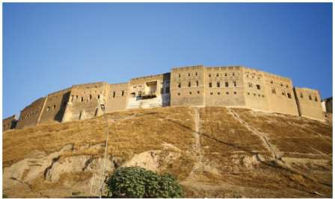
URBAN Origin & form:
Urbanism – the way life fostered by urban settings, in which the number, physical density, & variety of people result in distinctive attitudes, values, & patterns of behavior.
Urban origins – historical context of the growth of cities, long period of development
Urban system – an interdependent set of urban settlements within a region.
Urban form – the physical structure, & organization of cities in their land use, layout, & built environment
Urban ecology – the social & demographic composition of city districts & neighborhoods.
Figure 10.3 The fortress city of Erbil in northeast Iraq

Slide 6
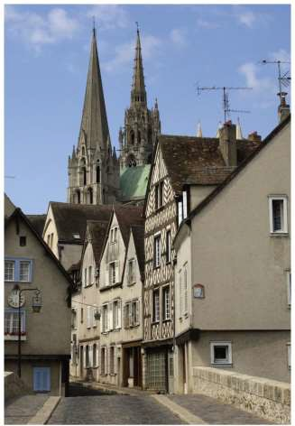
European Urban Expansion
Occurred with the end of Feudalism
Towns depended on these roles:
  Ecclesiastical or university center
  Defensive stronghold
  Administrative centers
Figure 10.5 Chartres, France

Slide 7
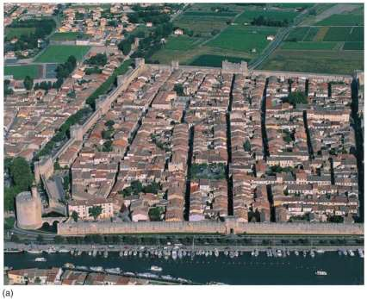
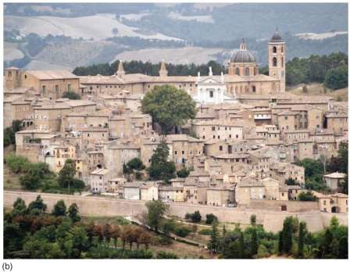
Figure 10.6a Aigues-Mortes, France
Figure 10.6b The 13thC strategic center of Urbino, Italy
Walled medieval town in southern France, best preserved example of 13th- century military architecture Surrounded by wall with 5 towers & 10 fortified gates
Also a Port city with sea access via dug canals through ponds & marshes of Camargue region
Urbino, Italy, strategic urban center in 13th century with hilltop defensive site, artistic center during Renaissance

Slide 8
Industrial Cities
A Shock city is the embodiment of surprising & disturbing economic, social, and cultural changes in urban life.
Manchester, England & Chicago, IL, USA were archetypal forms of an entirely new kind of city, the industrial city, fundamental reasons for existence to assemble raw materials & to fabricate assemble, & distribute manufactured goods.
Unprecedented rates of growth & economic, social, & political problems.

Slide 9
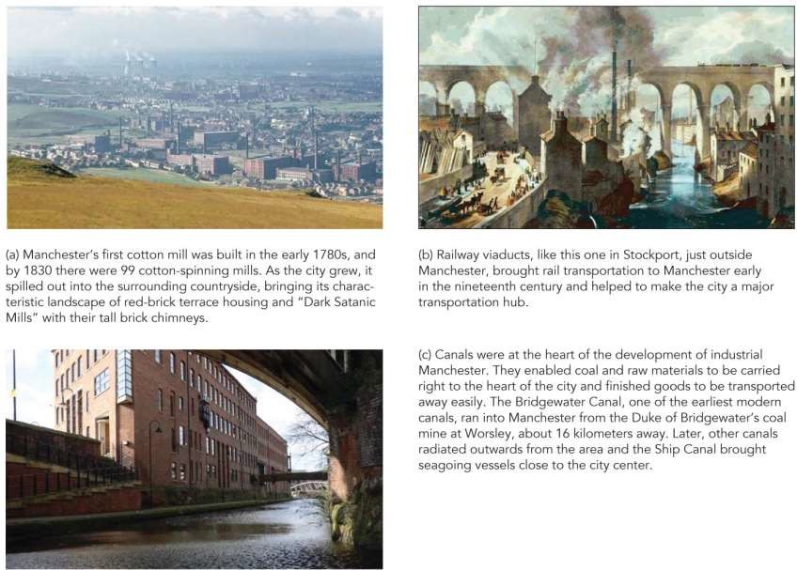
Industrialization and Urbanization: Shock city
Figure 10.12 Manchester, England: The "shock city" of the 19th Century

Slide 10
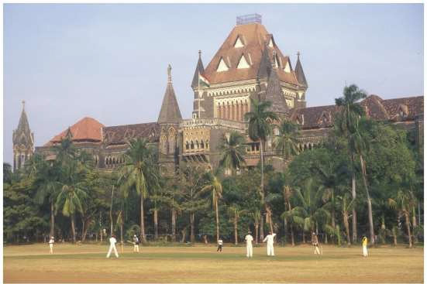
Colonial Cities
European imperialism
"Established" or planted Colonial functions grafted onto an existing settlement
[Insert Figure 10.15]
Figure 10.15 Mumbai, an example of colonial architecture and urban design

Slide 11
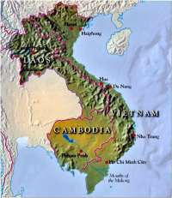
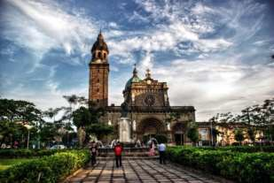
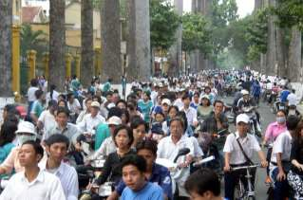
Imperialism & Peripheral Urbanization
Colonial cities were deliberately established administrative & commercial centers
The colonial city was “planted” in locations where no significant urban settlement had previously exited. Mumbai, Kolkata, India. Ho Chi Minh City, Hong Kong, Jakarta, Manila, & Nairobi
Colonial functions were grafted onto existing settlement, good locational site advantage, labor.
Ho Chi Minh City, Vietnam

Slide 12
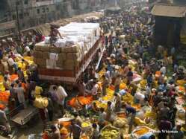
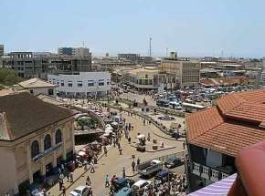

Gateway Cities –
PORTS in periphery serving the CORE of
Colonial Europe
Kolkata, India
Accra, Ghana
Link between one country or region & others due to physical situation
Colonial control centers command entrance to & exit from that country or region
European powers developed 1,000’s of towns globally to extend their trading networks & establish colonies.
Ports & Cities grew, settlement expanded into continental interiors.
Rio de Janeiro – Gold mining, Buenos Aires – Mutton, wool, & cereals, Sao Paulo – Coffee
Kolkata, India – Jute, cotton, & textiles, Accra, Ghana – Cocoa

Slide 13
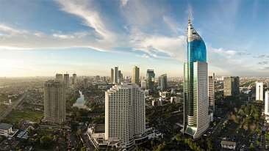
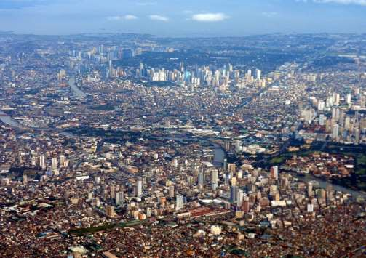
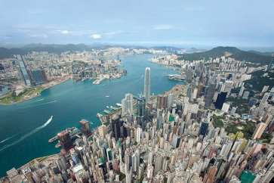
Former colonial World Cities:
Manila, Philippines (left), Jakarta, Indonesia (below) & Hong Kong (lower left

Slide 14
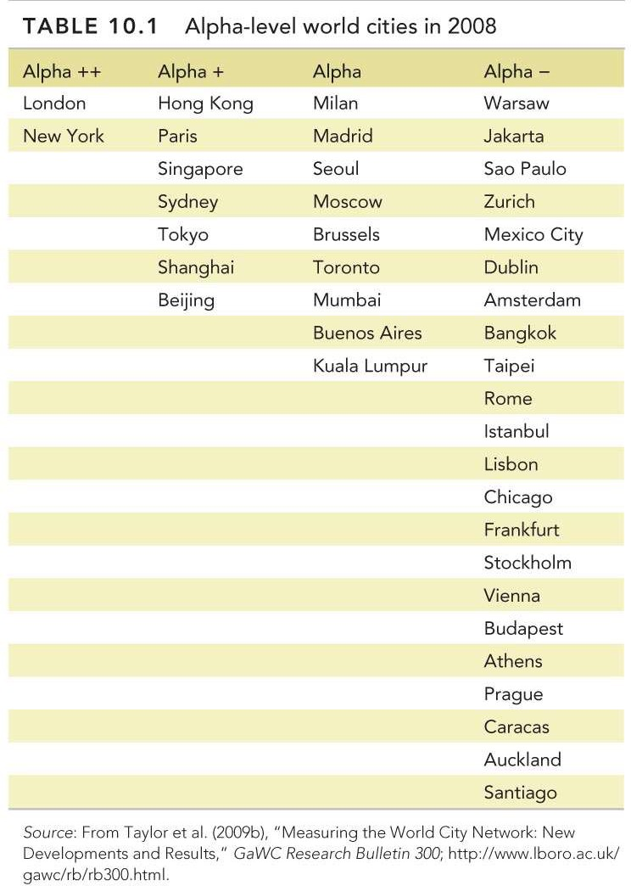
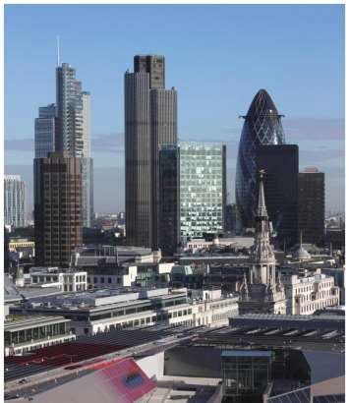
Urban Systems
Figure 10.19 The "square mile" of the city of London
TOP-TIER CITIES: Financial
centers – London, New York

Slide 15
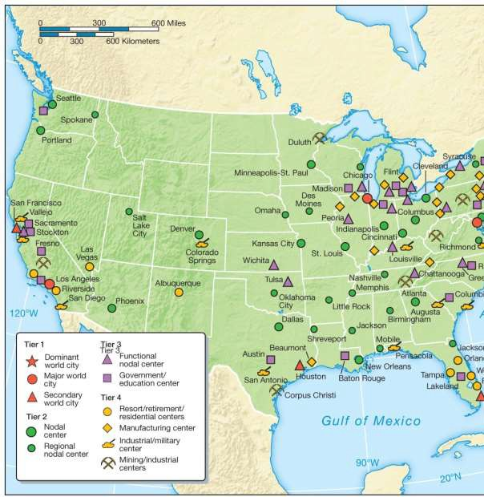
United States Urban Systems
Shape or morphology of U.S. cities changed:
With automobile &
highway systems.
Federal mortgage Programs enabled people into suburban areas.
Federal Housing Discrimination of “Redlining” kept African Americans segregated & without home loans.
Figure 10.17 Functional specialization within an urban system

Slide 16
Urban Periphery: Over-urbanization
Rural Migrants migrate to cities for opportunity.
Exceptionally high rates of population increase. Occurs when cities grow more rapidly than they can sustain jobs & housing.
Produces instant slums on unpaved streets with open sewers & no utilities.
Housing is substandard to say the least; shacks constructed of planks, cardboard, tar paper, thatch, mud, & corrugated iron.
Concentrated in Africa, South America, Asia, & SW Asia – 1.75 BILLION PEOPLE LIVE THIS WAY
  2 out of 7 People on Earth live this way
Result of disruption of Rural Societies by Globalizing forces of
Agricultural restructuring.

Slide 17
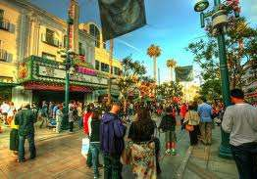
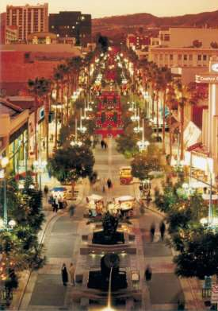
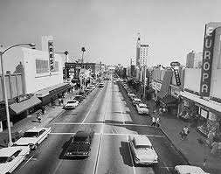
North American City Structure
Central business district
(CBD) – traditional city development based on urban center with administrative functions including government, banking, law, education, & retail functions. Taller buildings & monumental architecture.
Zone in transition – as city space evolves & changes, previous zones of industrial use fall into decay, may develop into new business with different land use; mixture of growth, change & decline.
Historic 3rd Street Central Business District
In Santa Monica, CA 1950’s to 2014
pedestrian mall
Figure 11.2 Chicago's
“Globalized” Financial CBD

Slide 18
The Core:
Urban Problems in Mature cities
Deindustrialization – People lose jobs!
Agglomeration – concentration of industry types in urban areas such as auto industry, manufacturing, and now IT
Diseconomies – loss of manufacturing overseas results in related industries closing, loss of jobs
Decentralization of jobs and people
Counter-urbanization – populations leaving American cities
Re-urbanization – repopulation of U.S. cities
© 2013 Pearson Education, Inc.

Slide 19
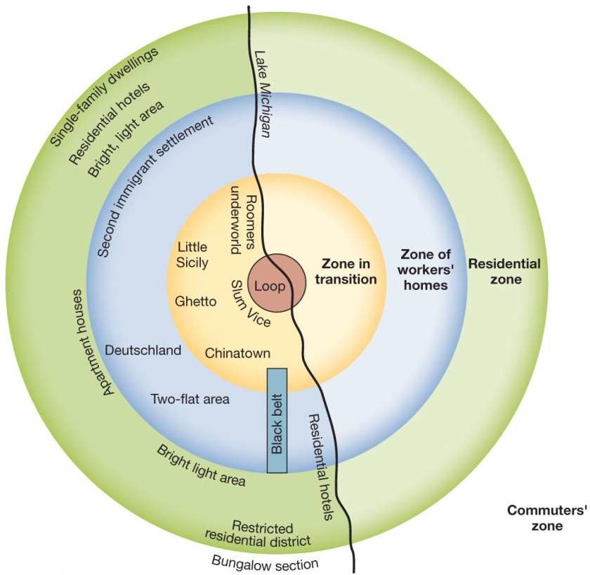
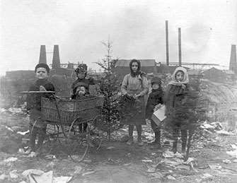
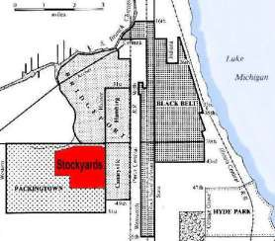
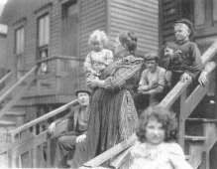
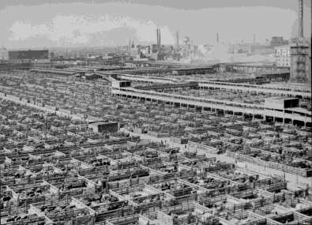

Chicago urban land use
http://www.chicagohs.org/history/stockyard/stock6.html
Kids in the Dump yards of Chicago
http://www.chicagohs.org/history/stockyard/sto
Worker Housing
Figure 11.3 The ecological model of urban
land use – The “Chicago Model”
Zones of concentric land use in a model City. Central business district (CBD) at center, location of original agricultural farmers’ markets, livestock transport & slaughter, rail yards for shipping nationally & regionally.
Manufacturing. Historic ethnic enclaves with distinct cultural fabric in proximity to groups experiencing discrimination due to race and ethnicity.
Chicago Union Stockyards, Railroads Manufacturing Zones

Slide 20
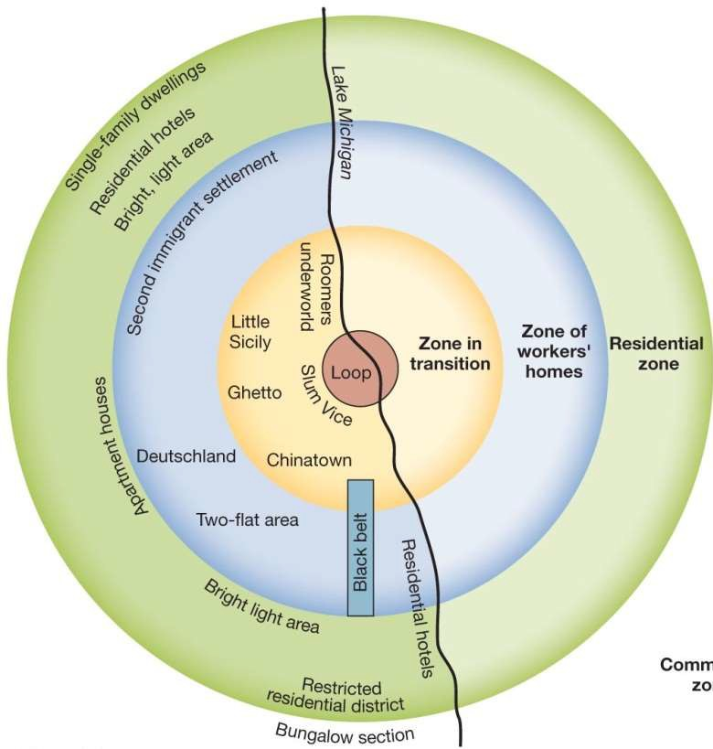
Central Place theory:
Concentric Zones of urban activity in an
American city from mid to late 19th century to mid- 1970s of de- industrialization; Zone in Transition-
© 2013 Pearson Education, Inc.

Slide 21
Urban Population & Congregation
Congregation provides a means of cultural preservation. Allows religious & cultural practices to be maintained & strengthens group identity through daily involvement in routines & ways of life.
Minority groups are population subgroups that are perceived as different from the general population. Defining characteristics of minority groups can be based on race, language, religion, nationality, caste, sexual orientation, or lifestyle.
Segregation – The combined result of congregation & discrimination, the spatial separation of specific subgroups within a wider population.
  Enclaves are tendencies toward congregation & discrimination are long-standing but dominated by internal cohesion.
  Ghettos long-standing products of discrimination than congregation.

Slide 22
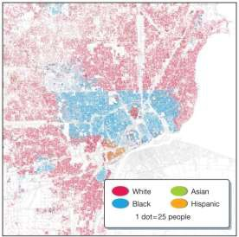
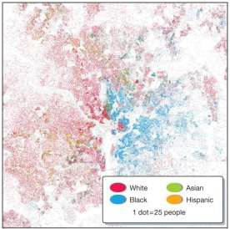
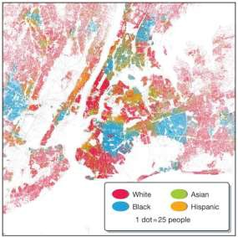
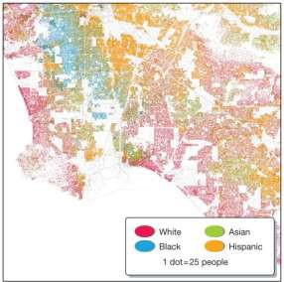
U.S. Racial Segregation
Segregation – The combined result of congregation & discrimination, the spatial separation of specific subgroups within a wider population.
Detroit
Washington, D.C.
Development of American Cities reflect historical trend of racial segregation
New York
Long Beach
Figure 11.a,b,c,d

Slide 23
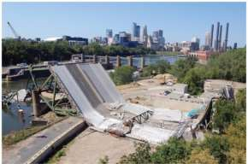
Problems of North American Cities
Central cities – inner-city cores experience decay, crime, poverty.
Fiscal squeeze – Occurs when tax revenue goes down (businesses leave area, homeowners move out) plus increasing demand for money to improve & support urban infrastructure & city services.
Detroit – entire industry leaves & city disintegrates
Infrastructure – Bridges, roads, Sewers, electrical g
Transportation all has to be maintained
Poverty- lower wage populations who
need support to escape cycle of poverty.
Neighborhood decay – lack of investment in mainte
low income areas needs investment
Redlining – racial/financial profiling of homebuyers – nice word for economic Racism. Contributes to economic decline by undermining neighborhood stability.
rids,
nance of properties -
Figure 11.10 Tragedy in Minneapolis

Slide 24
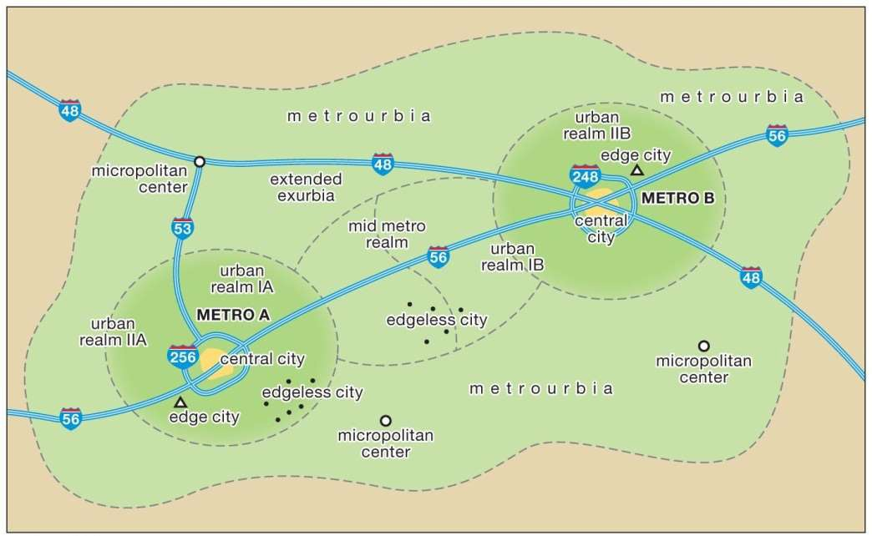

Spatial Organization
Figure 11.8 Metroburban landscapes – merging of urban centers with edge cities of residences, retail centers, & business parks. Commute times are extended but over time the regions merge into interconnected metro-urban areas.
Figure 11.9 Gentrification in Philadelphia – Elite economic class enjoys revitalization of older core residences near the CBD & Downtown of American cities. Controversial for displacing lower income residents

Slide 25
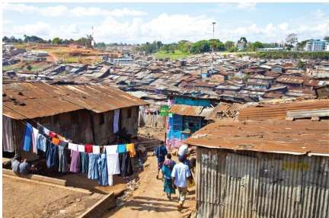
World Urbanization Today
Over-urbanization
Squatter settlements
Megacities –
Very large cities
characterized by
both primacy & a
high degree of centrality
Informal sector of the economy, activities off official records & not subject to formal regulation, “getting paid”, also centers of self-help networks & community organization. Serves the city core.
[Insert Figure 10.23]
Figure 10.20 Slum housing in Nairobi, Kenya, a peripheral city

